Slide 1


Discover the Hidden Gem: El Paraiso Escondido
Welcome to El Paraiso Escondido, a charming boutique hotel nestled in the heart of the Spanish countryside. Offering a serene and luxurious escape, our hotel invites you to immerse yourself in the rich culture and natural beauty of this hidden gem. From our exquisite accommodations to our mouthwatering culinary delights, we strive to provide an unforgettable experience that will leave you feeling refreshed and rejuvenated.

Slide 2
Rooms to Suit Every Taste
Presidential Suite
Executive Suite
Junior Suite
Indulge in the ultimate in luxury and comfort with our spacious Presidential Suites. Featuring plush furnishings, private balconies, and stunning views, these suites offer the perfect retreat for the discerning traveler.
Designed with the modern business traveler in mind, our Executive Suites provide a seamless blend of elegance and functionality. Enjoy ample workspace, high-end amenities, and a peaceful ambiance to help you stay productive and refreshed.
Cozy and charming, our Junior Suites offer a delightful balance of comfort and style. With their warm decor, ample living space, and thoughtful touches, these suites provide the perfect home away from home for your Spanish getaway.

Slide 3
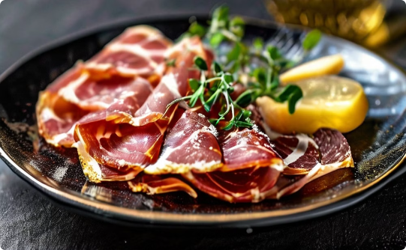
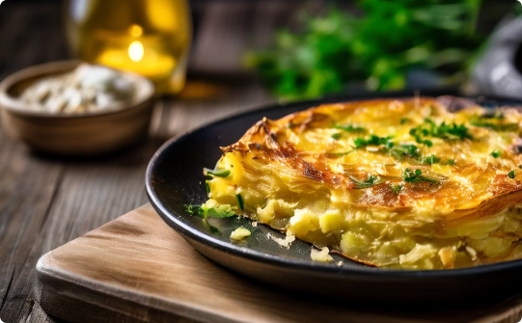
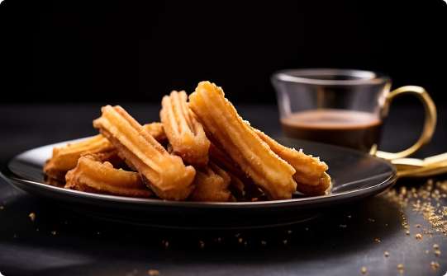
Savor the Flavors of Spain
Jamón
Tortilla Española
Churros
Indulge in the rich, savory flavors of our premium Jamón, a Spanish delicacy that has been cured to perfection. Savor each bite and let the flavors transport you to the heart of Spain.
Experience the authentic taste of Spain with our homemade Tortilla Española, a beloved dish that combines fluffy eggs, tender potatoes, and caramelized onions for a truly satisfying and comforting meal.
Indulge in the irresistible crunch and sweetness of our freshly fried Churros, a classic Spanish treat that pairs perfectly with a rich, velvety chocolate dipping sauce.

Slide 4
Delectable Tapas and More
1
Croquetas
2
Albondigas
Savor the creamy, bechamel-based Croquetas, a beloved Spanish appetizer that features a crispy exterior and a delectable, flavor-packed interior.
Delight in the tender, flavorful Albondigas, traditional Spanish meatballs simmered in a rich, tomato-based sauce for a comforting and satisfying dish.
3
Italian Cuisine
4
Leche Frita
Discover our selection of authentic Italian dishes, expertly prepared with the finest ingredients and infused with the essence of the Mediterranean.
Indulge in the unique and delightful Leche Frita, a traditional Spanish dessert featuring creamy, fried custard squares dusted with cinnamon sugar.

Slide 5
Refreshing Sips and Bites
Gazpacho
Pizza
Savor the cool, refreshing flavors of our authentic Gazpacho, a chilled Spanish soup made with ripe tomatoes, crisp vegetables, and a hint of tangy vinegar.
Indulge in our delectable selection of pizzas, featuring a variety of toppings and a perfectly crisp, wood-fired crust that will delight your taste buds.
Pasta
Baked Spaghetti
Enjoy a taste of Italy with our expertly crafted pasta dishes, made with the finest ingredients and infused with the rich flavors of the Mediterranean.
Discover the comforting and satisfying flavors of our Baked Spaghetti, a hearty dish featuring al dente pasta, a savory tomato sauce, and a melted cheese topping.

Slide 6



A Taste of Italy, Infused with Spanish Flair
Pizza Margherita
Pasta Dishes
Baked Spaghetti
Savor the classic flavors of our Pizza Margherita, featuring a crisp, wood-fired crust, tangy tomato sauce, and creamy mozzarella cheese, all infused with the essence of Spain.
Indulge in our selection of expertly crafted pasta dishes, where the rich, authentic flavors of Italy meet the vibrant, Mediterranean-inspired touches of Spain.
Discover the comforting and satisfying flavors of our Baked Spaghetti, a hearty dish that combines the classic Italian pasta with a savory Spanish-style tomato sauce and a melted cheese topping.

Slide 7
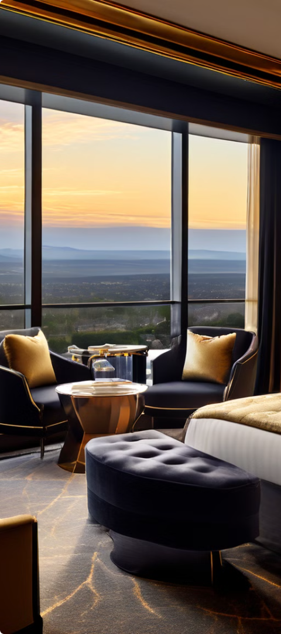



Unwind in Comfort and Style
Presidential Suite
Indulge in the ultimate in luxury and comfort with our spacious Presidential Suites, featuring plush furnishings, private balconies, and stunning views.
Executive Suite
Designed with the modern business traveler in mind, our Executive Suites provide a seamless blend of elegance and functionality, with ample workspace and high-end amenities.
Junior Suite
Cozy and charming, our Junior Suites offer a delightful balance of comfort and style, with warm decor, ample living space, and thoughtful touches.

Slide 8
Discover the Hidden Gem of Spain
Presidential Suite
2200 Euros
Executive Suite
1600 Euros
Junior Suite
1200 Euros
Single Room
350 Euros
Twin Room
720 Euros
Triple Room
1000 Euros
Connecting Rooms
1100 Euros

Slide 9
Dining and Drinks Menu
Food Items
Spicy Tastes
Dessert Selections
Pizza Margherita - €15,
Tortilla - €15
Tiramisu - €8,
Pasta Dishes - €18-22,
Cuisines - €12,
Gelato Assortment - €6,
Baked Spaghetti - €16
Gazpacho - €13
Churros with Chocolate Sauce - €7

Slide 10

Cherish the Essence of Spain
As your journey at our hotel comes to an end, we hope you've had the chance to truly unwind and immerse yourself in the captivating essence of Spain. Our hidden gem offers a harmonious blend of comfort, style, and cultural experiences that will leave a lasting impression.

